Slide 1
ENME-647-FINITE ELEMENT METHODS-WINTER 2023
FINAL PROJECT- ANSYS ANALYSIS
Team members :
1. | Singh Rajdeep | Geometry Modelling
2. | Vaghela Dhrumilkumar Anilbhai | Presenter/boundary conditions
3. | Bhamare Monil Mahendra | Developed problem solving strategy
4. | Parekh Parshwa Nimesh | Analysis for full body
5. | Trivedi Prithviraj Shyamkumar | Symmetric body analysis
6. | Ganesan Dhanush | PowerPoint designer

Slide 2
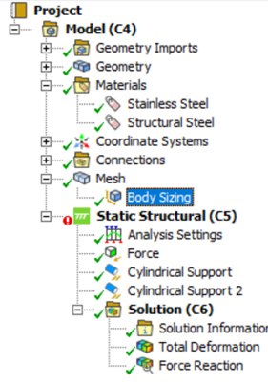
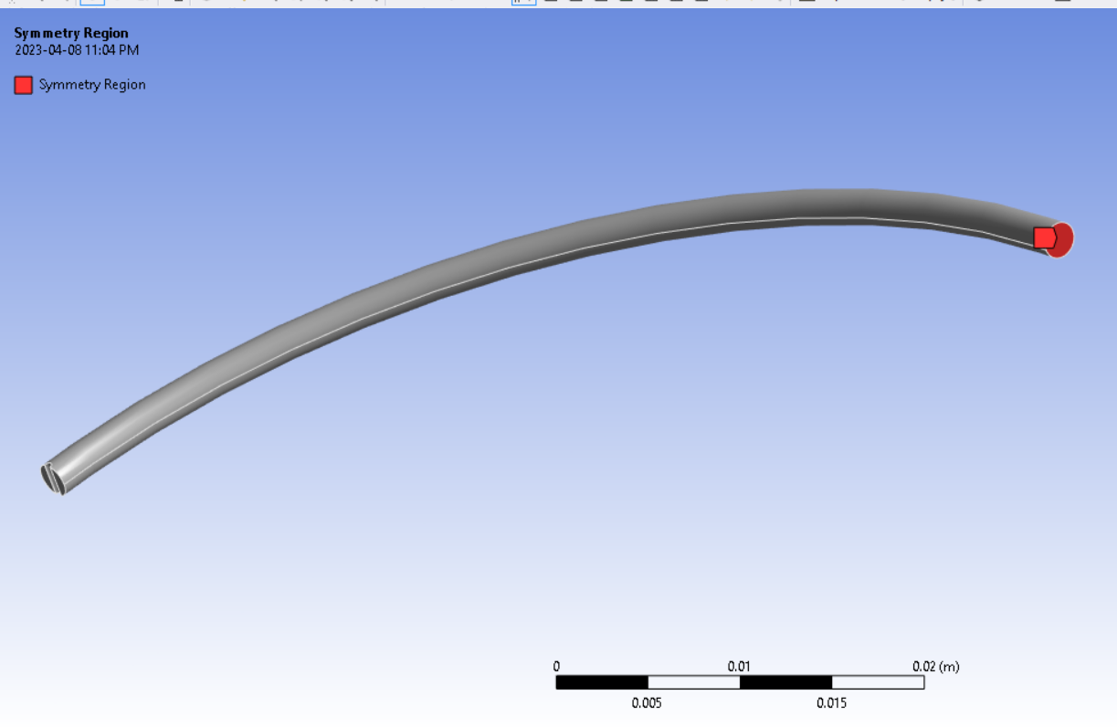
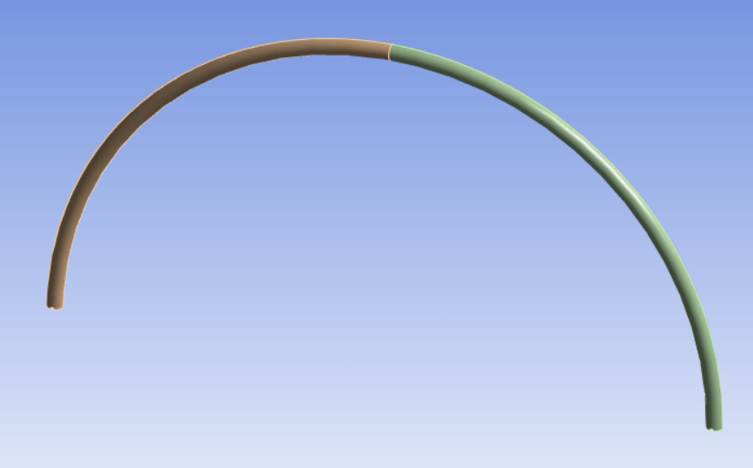
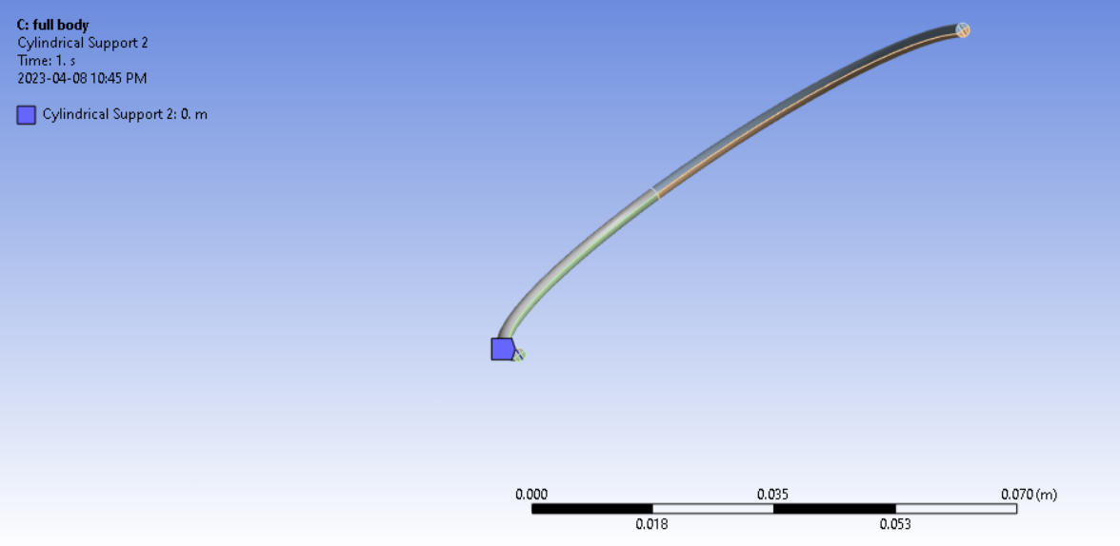
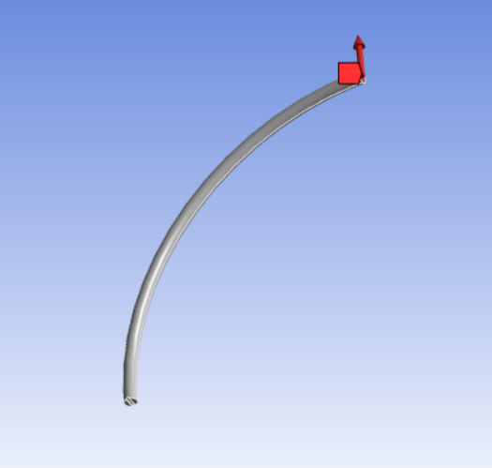
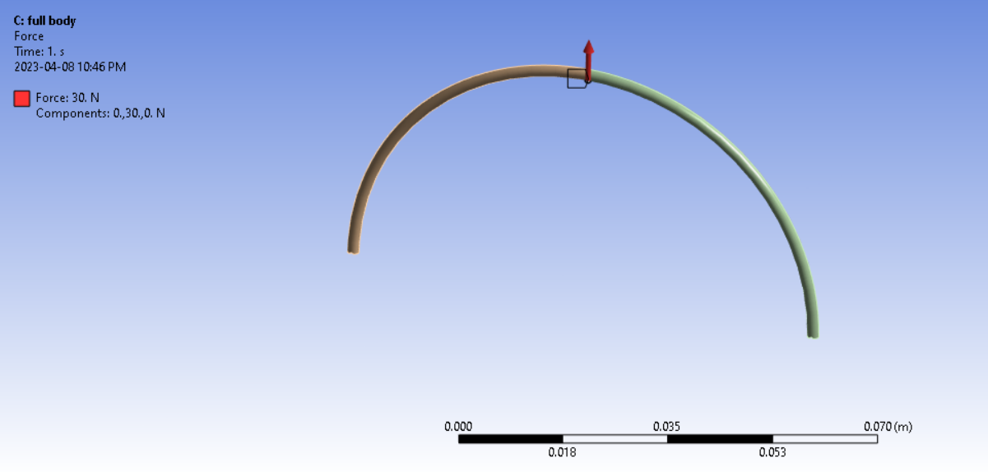
PROBLEM SOLVING STRATEGY AND BOUNDARY CONDITIONS
Symmetry strategy: Half-wire form
Half wire form is modeled and symmetry tool in used to find Total deformation and Force reaction.
Conventional strategy: Full-body form
Full wire form is modeled and given boundary conditions are applied to find Total deformation and Force reaction at the bottom.
Strategy:
Boundary conditions:
Support: Cylindrical Fixed Support Loads: Force
15N in Y Direction
At points A and B (bottom) point for Full and at point A for half
30 N at point C for full body

Slide 3

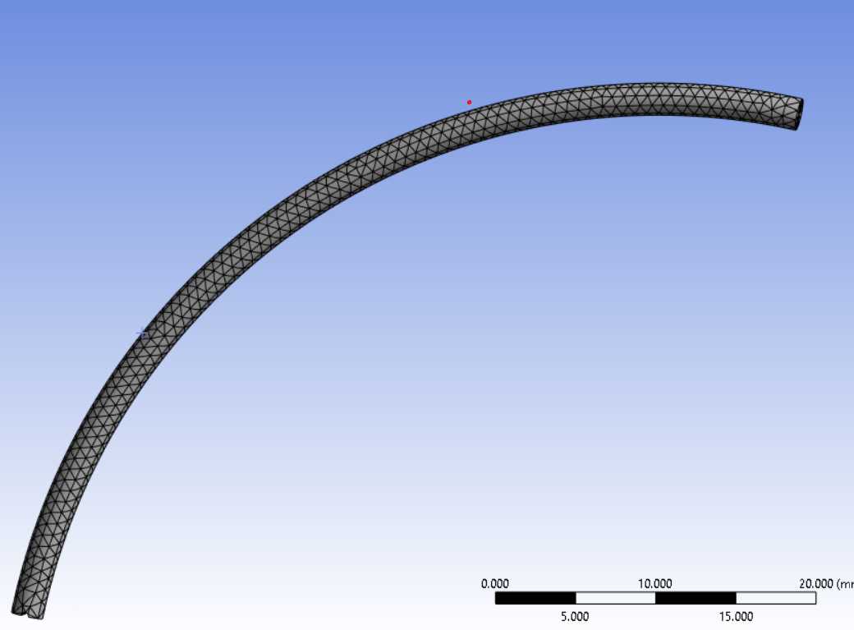
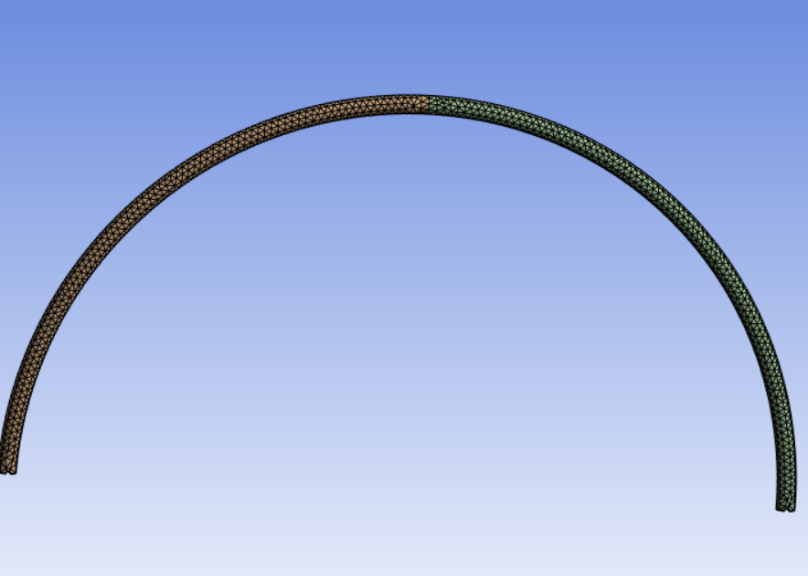
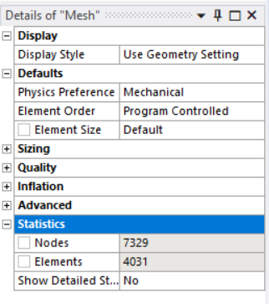
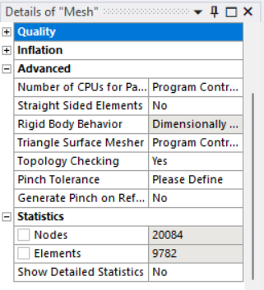
MESH DESIGN
Symmetry Approach
Full Geometry Approach
No. of NODES: 7329 No. of ELEMENTS: 4031
No. of NODES: 20084 No. of ELEMENTS: 9782
After trying different mesh sizes we found a mesh independent range and in that range at 0.75mm we found our result closest to the theoretical answer that’s why we took 0.75mm as a mesh size.

Slide 4
RESULTS & VALIDATION
Using ANSYS the solution is obtained as follows comparing with theoretical values:
SYMMETRY APPROACH | THEORETICAL VALUES | ANALYTICAL VALUES
TOTAL DEFORMATION | 0.224N | 0.25N
FORCE REACTION | 9.55N | 9.55N
CONVENTIONAL APPROACH | THEORETICAL VALUES | ANALYTICAL VALUES
TOTAL DEFORMATION | 0.224N | 0.25N
FORCE REACTION | 9.55N | 9.548N

